Slide 1
Hypothesis Testing

Slide 2
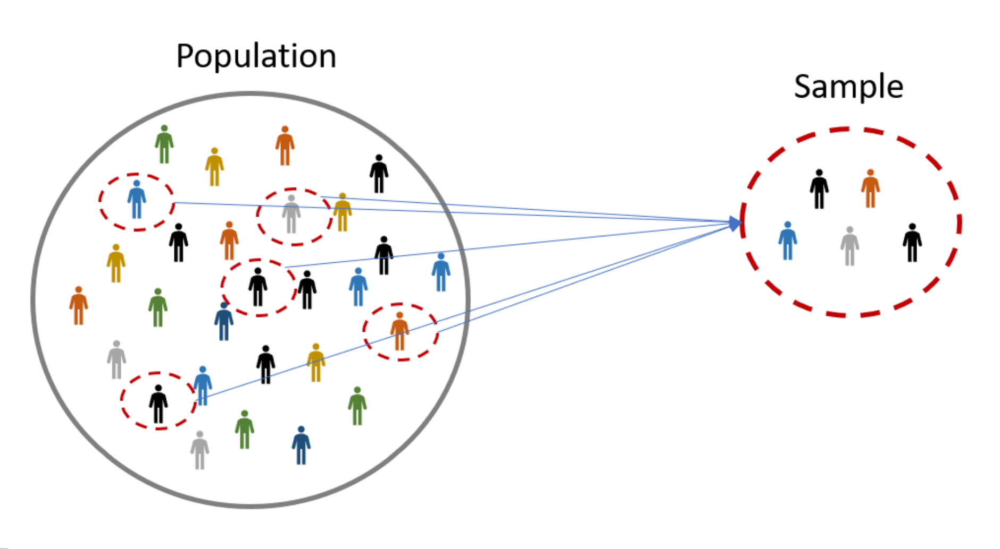

Population vs Sample
Hypothesis concerns population mean (μ)
Use sample mean ( ) to make the inference
$$\bar{x}$$
Image source: University of Rhode Island.

Slide 3

An educated guess
A hypothesis is basically “an educated guess” (Salkind & Frey, 2019)
Often used as a research question
Most important role is to:
reflect the general problem statement or question that was the motivation for asking the research question in the first place
?

Slide 4

Real life questions
There will be no difference between the average score of 9th graders and the average score of 12th graders on a memory test
There is no difference between the effectiveness of community-based, long-term care and the effectiveness of in-home, long-term care in promoting the social activity of older adults when measured using the Margolis Scale of Social Activities
There is no relationship between reaction time and problem-solving ability
There is no difference between high- and low-income families in the amount of assistance families offer their children in school-related activities
(Salkind & Frey, 2019)
Null Hypothesis
Notes:
What these four null hypotheses have in common is that they all contain a statement that two or more things are equal or unrelated (that’s the “no difference” and “no relationship” part) to each other.

Slide 5
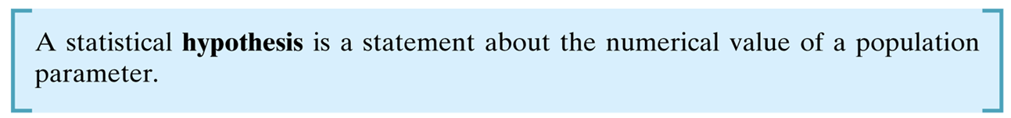

basic purposes of the null hypothesis
Null Hypothesis (H₀)
Represents the hypothesis that will be accepted unless the data provide convincing evidence that it is false
This usually represents the “status quo” or some claim about the population parameter that the researcher wants to test
Alternate (or Research) Hypothesis (H₁)
Represents the hypothesis that will be accepted if the data provide convincing evidence of its truth
This usually represents the values of a population parameter for which the researcher wants to gather evidence to support
?

Slide 6

Making a Judgement
“Innocent”… …until proven… “Guilty”
Basis of Justice system
Burden of proof is on Prosecution
Image source: Wikimedia Commons.

Slide 7
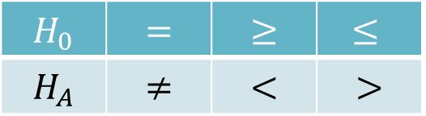
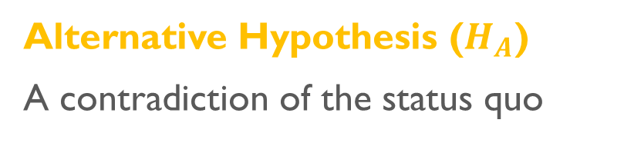
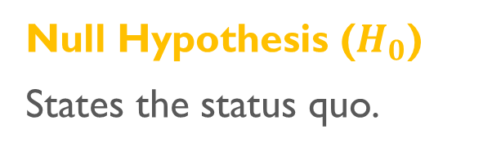
Hypothesis testing
Null Hypothesis ($H_{0}$)
States the status quo.
Alternative Hypothesis ($H_{A}$)
A contradiction of the status quo
If you set up your desired outcome as H₀, rather than H_{A}, you are biasing the study to “not reject” the finding you are looking for.
Use the following signs in hypothesis tests
← specify the status quo ← contradict H₀
Note that H₀ always contains the “equality”
$$H_{0}$$ | $$=$$ | $$≥$$ | $$≤$$
$$H_{A}$$ | $$≠$$ | $$<$$ | $$>$$

Slide 8
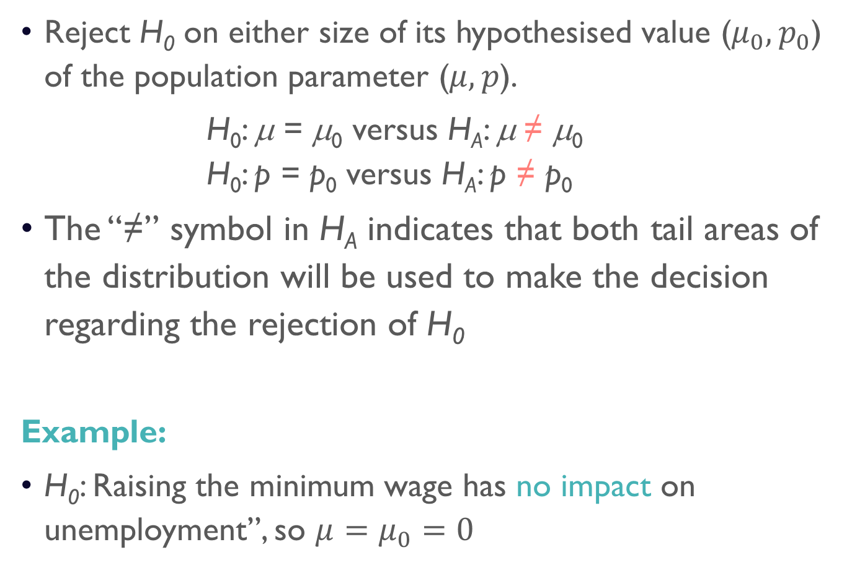
Two-tailed test
Reject H₀ on either size of its hypothesised value ($μ_{0},p_{0}$) of the population parameter ($μ,p$).
H₀: μ = μ₀ versus H_{A}: μ ≠ μ₀ H₀: p = p₀ versus H_{A}: p ≠ p₀
The “≠” symbol in H_{A} indicates that both tail areas of the distribution will be used to make the decision regarding the rejection of H₀
Example:
H₀: Raising the minimum wage has no impact on unemployment”, so $μ=μ_{0}=0$

Slide 9
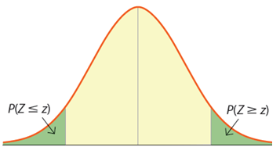



Two-tailed test
$\operatorname{Pr}{(}μ<μ0$)
$\operatorname{Pr}{(}μ>μ0$)
$$μ_{0}$$
The “≠” symbol in H_{A} indicates that both tail areas of the distribution will be used to make the decision regarding the rejection of H₀

Slide 10
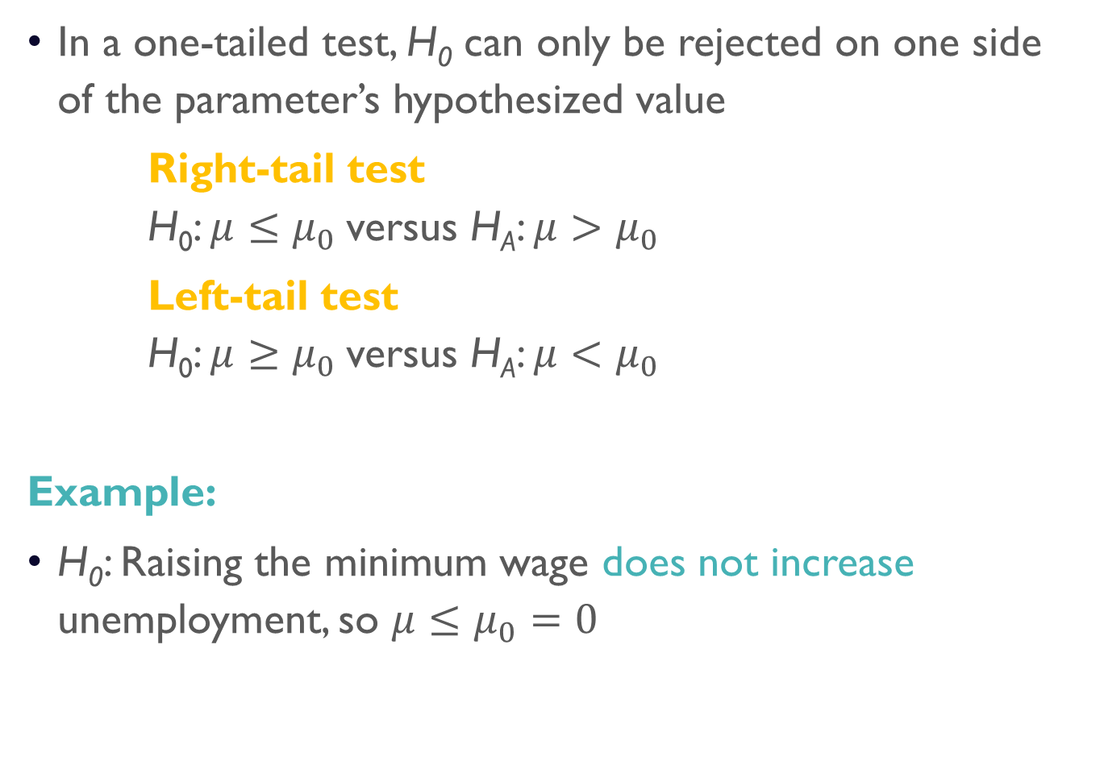
one-tailed test
In a one-tailed test, H₀ can only be rejected on one side of the parameter’s hypothesized value
Right-tail test H₀: $μ≤μ_{0}$versus H_{A}: $μ>μ_{0}$
Left-tail test H₀: $μ≥μ_{0}$versus H_{A}: $μ<μ_{0}$
Example:
H₀: Raising the minimum wage does not increase unemployment, so $μ≤μ_{0}=0$

Slide 11
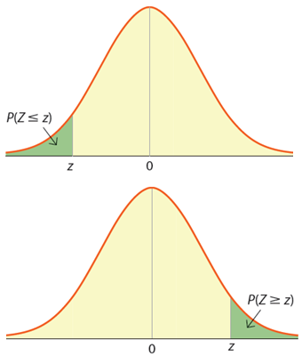


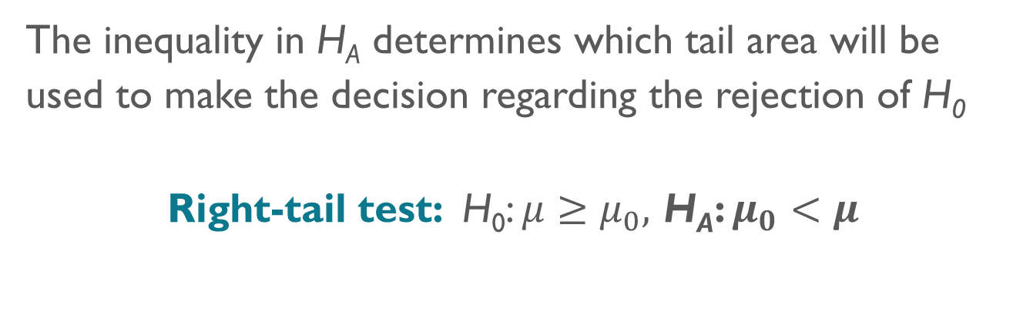
one-tailed test
The inequality in H_{A} determines which tail area will be used to make the decision regarding the rejection of H₀
Right-tail test: H₀: $μ≥μ_{0},$ H_{A}: $μ_{0}<μ$
$Pr\left(μ_{0}<μ\right)$
$$μ_{0}$$

Slide 12

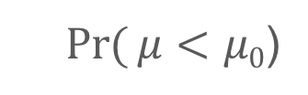
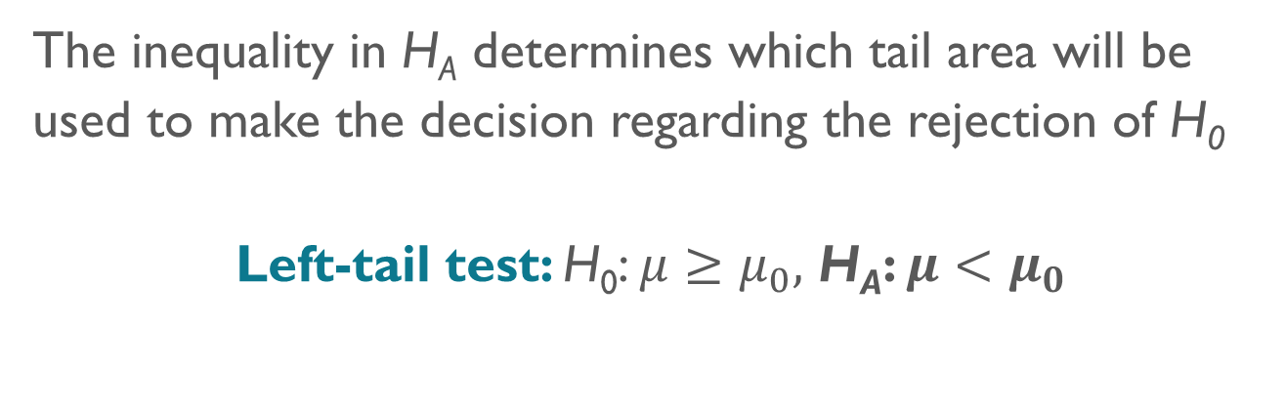
one-tailed test
The inequality in H_{A} determines which tail area will be used to make the decision regarding the rejection of H₀
Left-tail test: H₀: $μ≥μ_{0},$ H_{A}: $μ<μ_{0}$
$\operatorname{Pr}{(}μ<μ0$)
$$μ_{0}$$

Slide 13
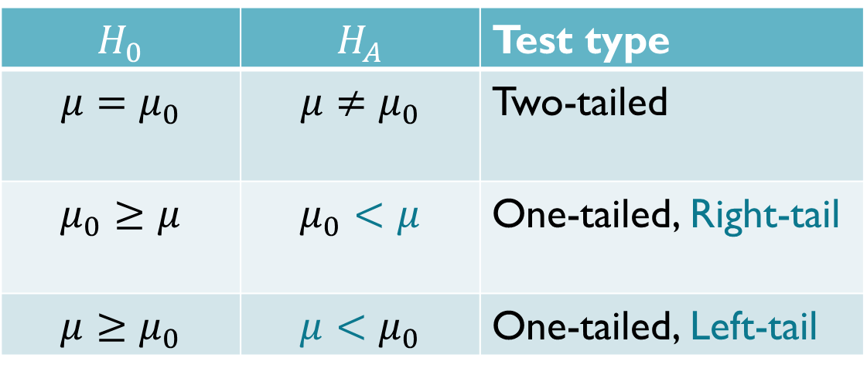
Hypothesis testing
Identify the relevant population parameter of interest.
Determine whether it is a one or a two-tailed test.
Include some form of the equality sign in H₀ and use H_{A} to establish a claim.
$$H_{0}$$ | $$H_{A}$$ | Test type
$$μ=μ_{0}$$ | $$μ≠μ_{0}$$ | Two-tailed
$$μ_{0}≥μ$$ | $$μ_{0}<μ$$ | One-tailed, Right-tail
$$μ≥μ_{0}$$ | $$μ<μ_{0}$$ | One-tailed, Left-tail

